Slide 1
0x40A – Searching in Ghidra
ECED4406 – Computer Security
Dr. Colin O’Flynn
Dalhousie University.

Slide 2
Searching…

Slide 3
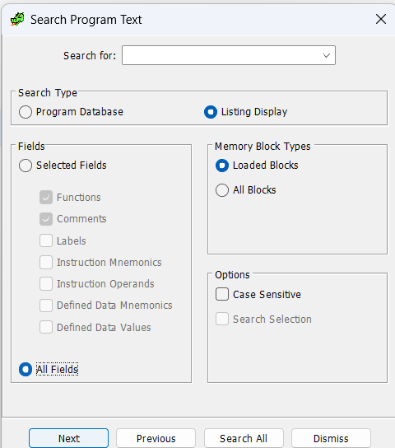
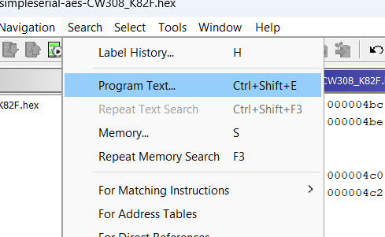
Searching… Program Text

Slide 4
Uses of Program Search
Can be helpful when you have ideas about program flow, looking for specific instructions.
Can find decoded constants, such as jump locations which are just stored as offsets, and other things that won’t show up by just searching memory.

Slide 5
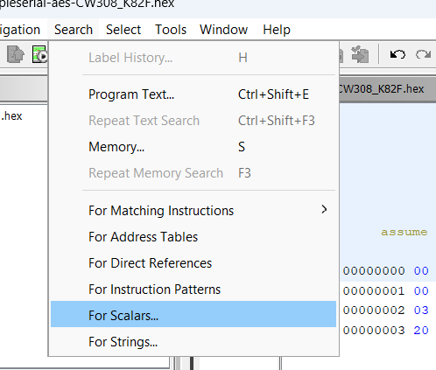
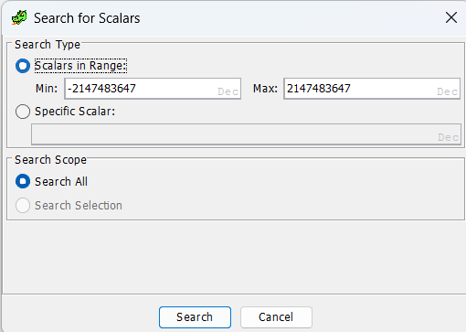
Searching… Scalars

Slide 6
Searching… Scalars
This will search for known scalars, which are constant values used in the program.
This can be helpful when you know some specific constant is used for e.g.:
A specific constant in a communications protocol
A specific constant in an algorithm

Slide 7
Scalar Searching Fails?
A few caveats that can cause this to fail:
If program is not disassembled, won’t know it’s a scalar.
Optimization may change the constant if part of a larger equation, due to equation rearranging.
Specific scalars which are non-integers may be stored in an unknown format.

Slide 8
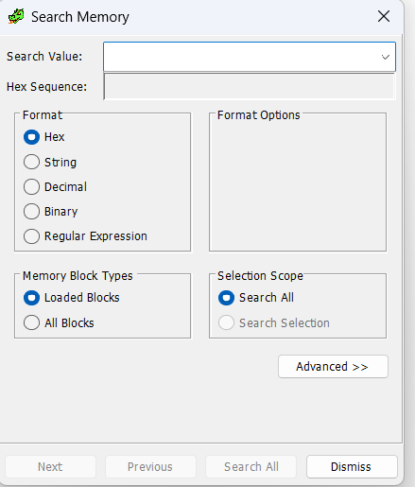
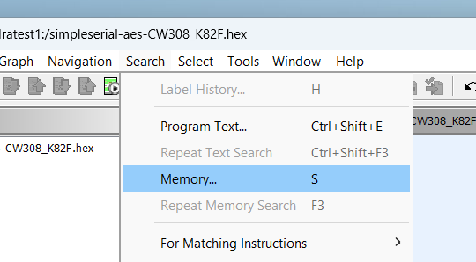
Searching… Memory

Slide 9
Searching Memory
Memory searches can be set to search “All Blocks”. Can search for specific values or byte sequences.
Byte sequences are very helpful, as you can find lots of things:
Protocol sequences such as headers.
Look-up tables with known contents.
Constants

Slide 10
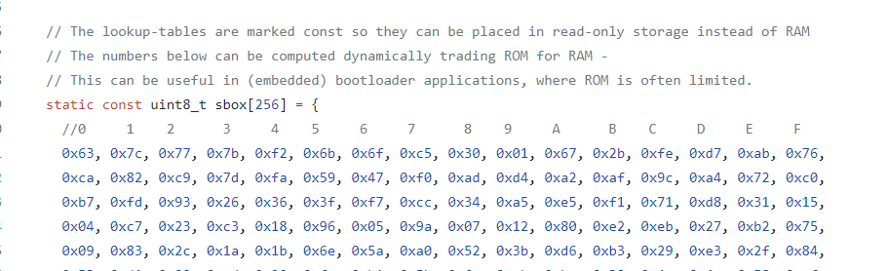
Identifying Cryptographic Functions

Slide 11
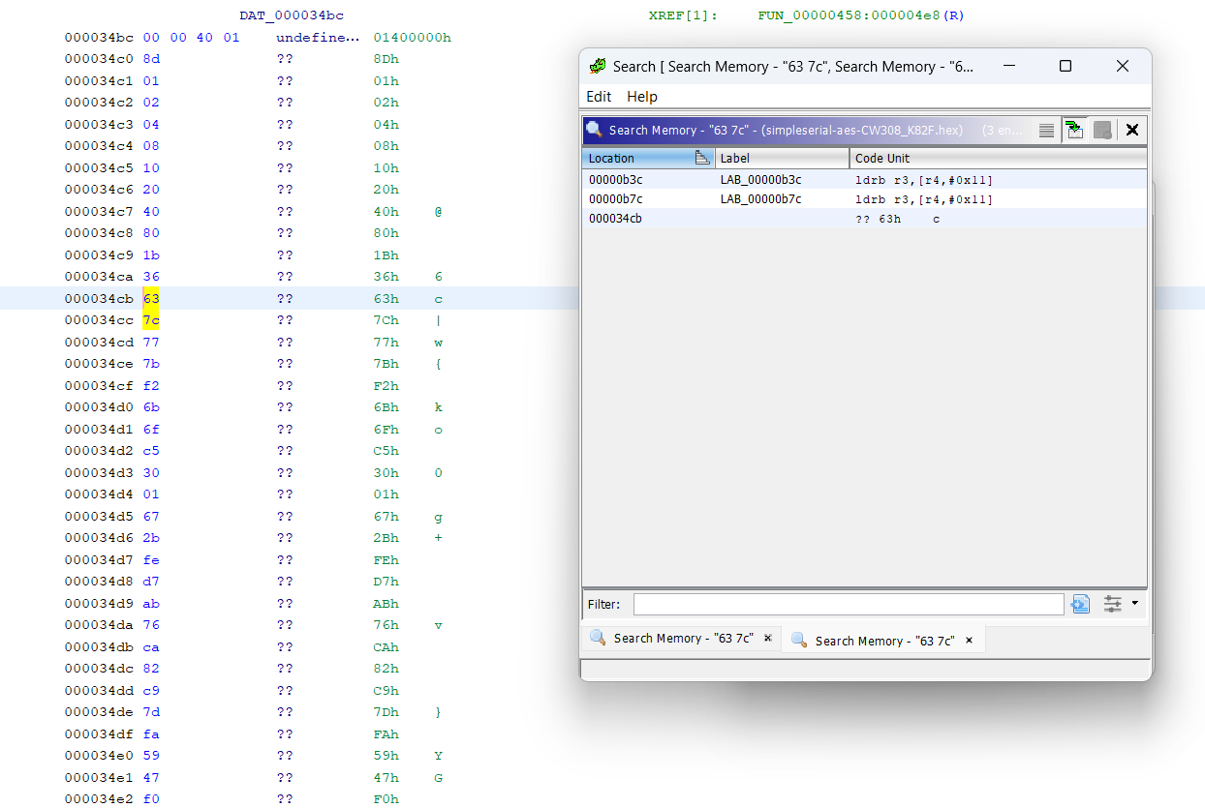
Search Memory Results

Slide 12
Searching & Static Analysis
Searching can be useful for determining where functions exist – but there is a natural limit.
A better solution is to use dynamic analysis. With dynamic analysis we use the program “live”, which requires more hardware and setup.

